Slide 1
Quarterly Market Outlook
First Quarter 2021

Slide 2
Contents
Who is CLS?
How did the markets perform?
How did CLS portfolios perform?
What is CLS thinking moving forward?
What is CLS doing with portfolios?

Slide 3
About CLS
Key Stats
Founded: 1989
Corporate Headquarters: Omaha, NE
Assets Under Management: $9.5B
Active Broker-Dealer Partners: 600+
Approved CLS Advisors: 6,600+
CLS Investors: Nearly 45,000 (institutional investors include several state 529 plans and prominent university endowment funds)
Website: www.clsinvest.com
Podcast: Orion’s The Weighing Machine
www.clsinvest.com/spotlight/the-weighing-machine
As of 08/31/2020

Slide 4
About CLS
Key Stats
Investment Team: 5
Investment Team Credentials:
    2 Chartered Financial Analyst (CFA®) Holders
    1 Chartered Alternative Investment Analysts (CAIA®)
    1 Certified Investment Management Analyst (CIMA®)
Industry Veterans: Experienced team with backgrounds from Fidelity Management & Research, Goldman Sachs, E*Trade, Charles Schwab, State Street, and TD Ameritrade

Slide 5



About CLS
Awards and Accolades
2017 ETF.com ETF Investor of the Year Winner*
4-Time ETF.com ETF Strategist of the Year Finalist*
2020, 2018, and 2016 WealthManagement.com ETF Strategist of the Year Winner*
2018 4-Category Finalist for WealthManagement.com Industry Awards*
2017 WealthManagement.com ETF Strategist of the Year Finalist*
Grant Engelbart, CFA, CAIA: One of the 2018 Top Ten Portfolio Managers to Watch
by Money Management Executive*
Social Media: 2,500+ Followers Across Platforms
CLS is Among the Top 10 shareholders in 71 ETFs**
Top Holder of 13 ETFs**
2019 ETF Investor of the Year Winner*
*This material is not complete without the information located at the end of this presentation.
**Data from Bloomberg as of 12/31/2020
0112-CLS-01/15/2021

Slide 6
Summary
Market Outlook
  Stocks: stay global
    We expect below-average returns from U.S. equities.
    We expect better returns from international equities.
  Bonds: be flexible
    Return expectations are also tempered.
    Bonds still have a role, but investors may need to be active with bond positioning.
0112-CLS-01/15/2021

Slide 7
Market Review
Performance Q1 2021
Fixed Income | 10 Year | 5 Year | 3 Year | 1 Year | YTD | QTD
Cash Equivalent Morningstar Cash Index | 0.58 | 1.13 | 1.50 | 0.48 | 0.48 | 0.02
U.S. Bonds BBgBarc US Agg Bond TR USD | 3.84 | 4.43 | 5.34 | 7.51 | 7.51 | 0.67
Stock Market | 10 Year | 5 Year | 3 Year | 1 Year | YTD | QTD
Global Equity Market Morningstar GblMkt Large-Mid NR USD | 9.20 | 12.23 | 9.98 | 16.12 | 16.12 | 14.84
Total U.S. Market Morningstar US Market TR USD | 13.90 | 15.52 | 14.63 | 20.90 | 20.90 | 14.23
Domestic Large-Cap Equity Morningstar US Large Cap TR USD | 14.38 | 16.13 | 15.69 | 21.72 | 21.72 | 11.40
Domestic Small-Cap Equity Morningstar US Small Cap TR USD | 10.99 | 12.25 | 8.82 | 16.41 | 16.41 | 29.29
International Equity Morningstar Gbl xUS Large-Mid NR USD | 5.19 | 9.12 | 5.22 | 11.12 | 11.12 | 17.19
Developed International Equity Morningstar DM xUS Large-Mid NR USD | 5.44 | 7.90 | 4.56 | 8.38 | 8.38 | 15.77
Emerging Market Equity Morningstar EM Large-Mid NR USD | 4.10 | 13.05 | 6.82 | 18.37 | 18.37 | 20.69
Diversifiers | 10 Year | 5 Year | 3 Year | 1 Year | YTD | QTD
Real Estate Morningstar Gbl Real Estate NR USD | 5.79 | 5.27 | 2.33 | -5.72 | -5.72 | 10.31
Commodities Bloomberg Commodity TR USD | -6.50 | 1.03 | -2.53 | -3.12 | -3.12 | 10.19
Diversified Alternatives Morningstar Diversd Alt TR USD | 1.65 | 1.20 | 0.33 | -2.58 | -2.58 | 5.45
Morningstar Direct as of 12/31/20
0112-CLS-01/15/2021

Slide 8
Market Review
What Worked & What Didn’t Work in the Markets 4Q 2020
What Worked
Equities
Latin America
Value
Small- Cap Sector
Fixed Income
Preferred Securities
Emerging Market Bonds
High Yield
Alternatives/Real Assets
Commodities / Agriculture
What Didn’t Work
Equities
Utilities
Middle East
Large-Cap Growth
  Fixed Income
  Treasuries
  Mortgage-Backed Securities
  Long-Term Bonds
Alternatives/Real Assets
Gold
0112-CLS-01/15/2021

Slide 9
Market Review
What Worked & What Didn’t Work in the Markets Year in Review
What Worked
Equities
US Consumer Cyclical
US Technology
EM Asia
Fixed Income
Treasuries
TIPS
Preferred
Alternatives/Real Assets
All Commodities (Gold, Agri, Ind. Metals, etc)
What Didn’t Work
Equities
Energy
Latin America
Emerging Markets Europe
  Fixed Income
  Short-Term
  Senior Loans
  High Yield
Alternatives/Real Assets
Real Estate
0112-CLS-01/15/2021

Slide 10
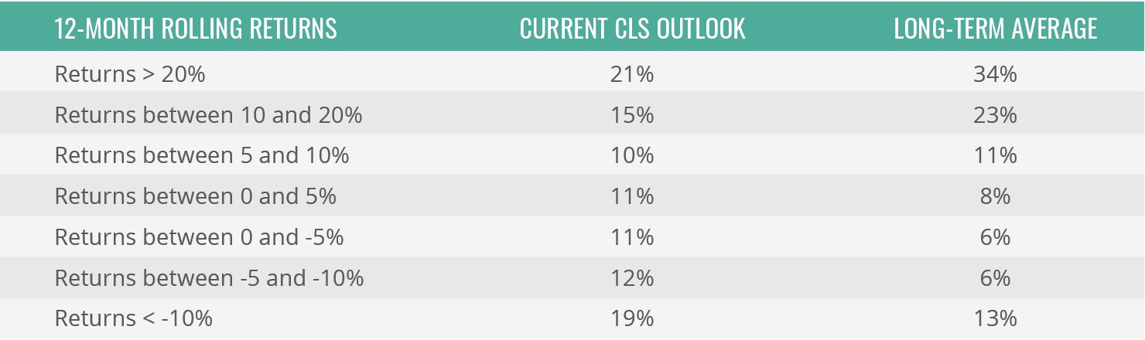
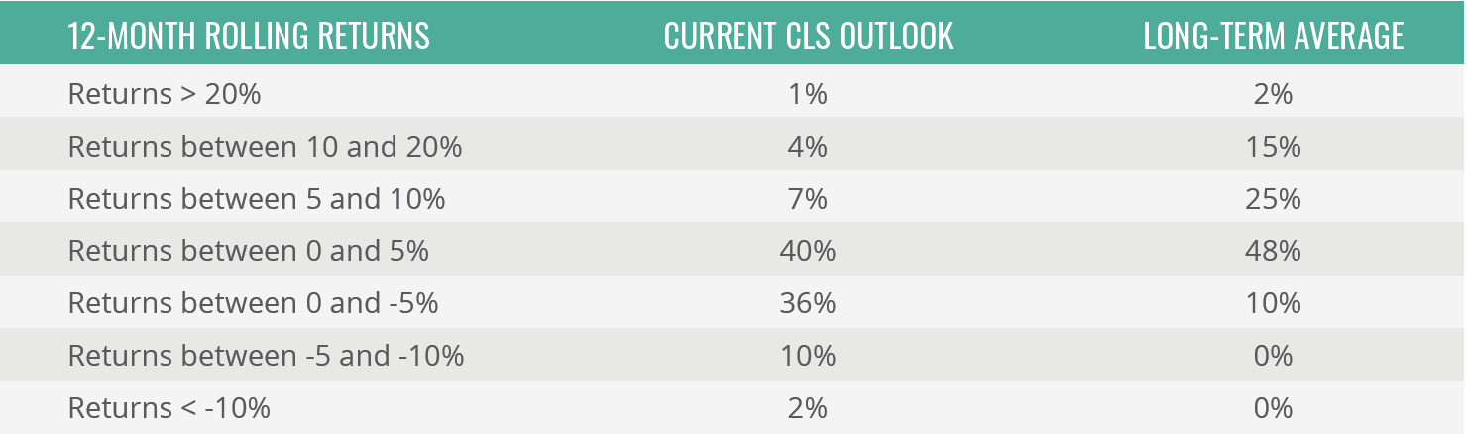
CLS 12-Month Markets Outlook:
12-MONTH EQUITY MARKET OUTLOOK
12-MONTH BOND MARKET OUTLOOK
We currently believe that returns for the equity market will be below the long-term average over the next 12 months.
In summary, we believe there is a 57% probability that the U.S. equity markets will produce a positive return in the next 12 months, with a 36% chance of a double-digit return.
We currently believe that returns for the bond market will be below the long-term average over the next 12 months.
In summary, we believe there is a 52% probability that the U.S. bond markets will produce a positive return in the next 12 months, with a 40% chance of return between 0% and 5%.
Numbers as of 11/30/2020
Past performance is not a guide to future performance. Individual client accounts may vary. Probabilities are based on calculations from CLS portfolio managers and research analysts. The CLS outlook is comprised of equal-weighted portfolio manager forecasts in five different return categories. The analyst team is equal weighted to count as a single portfolio manager vote. Historical probabilities for the five categories are also researched. Overall views which are presented have been adjusted based on perceived value by each portfolio manager and analyst.
*Source: Robert Shiller. The sum of the figures may be lesser or greater than 100% due to rounding.
0112-CLS-01/15/2021

Slide 11
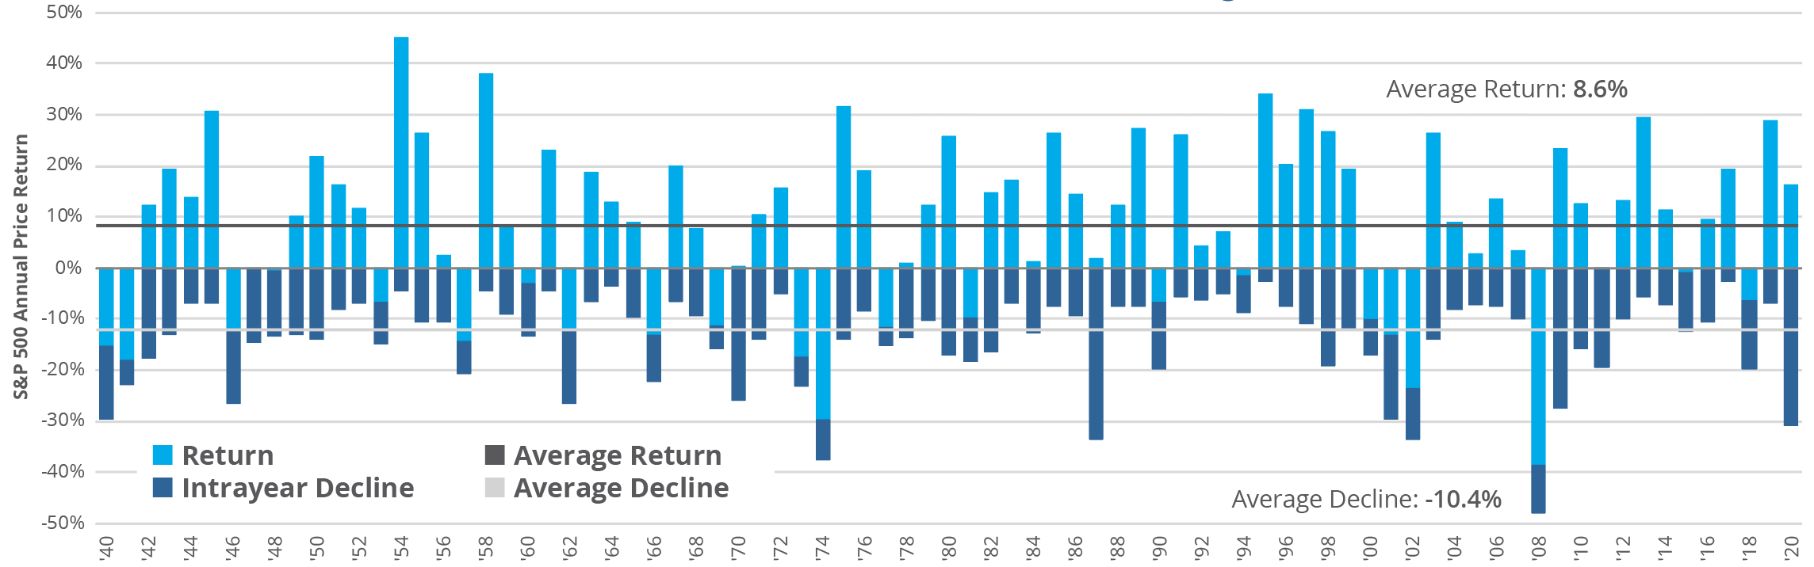
Stocks:
Managing Expectations
In 2020 the market low during the year was -30.75%; however, the market ended the year up 16.3%.
Investors who exited the market during the lows would have missed out on a large upside gain.
S&P 500 Annual Return, with Market Low During Year
Source: Morningstar Direct 12/31/2020. Returns are based on price index only and do not include dividends. Blue bars represent intra-year drops which refers to the largest market drops from a peak to a trough during the year. Returns are calendar year returns from 1940 to 2019.
0112-CLS-01/15/2021

Slide 12
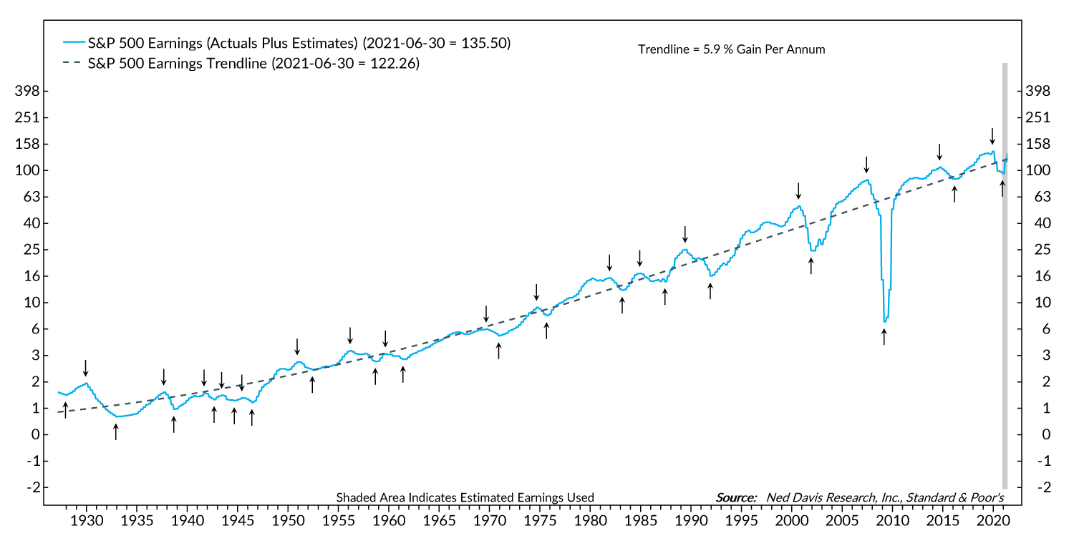
Stocks:
S&P 500 Earnings Growth – Monthly Data 03/31/1927 to 6/30/2021
U.S. Earnings Growth
Despite earnings growth being flat for 2019, the markets had very strong returns.
We anticipate below average returns this year for the U.S. stock market. We anticipate increased volatility may be
on the horizon.
Copyright 2021 Ned Davis Research, Inc. Further distribution prohibited without permission. All Rights Reserved. See NDR Disclaimer at www.ndr.com/copyright.html.
For data vendor disclaimers refer to www.ndr.com/vendorinfo/.
0112-CLS-01/15/2021

Slide 13
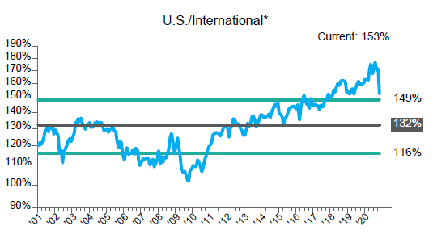
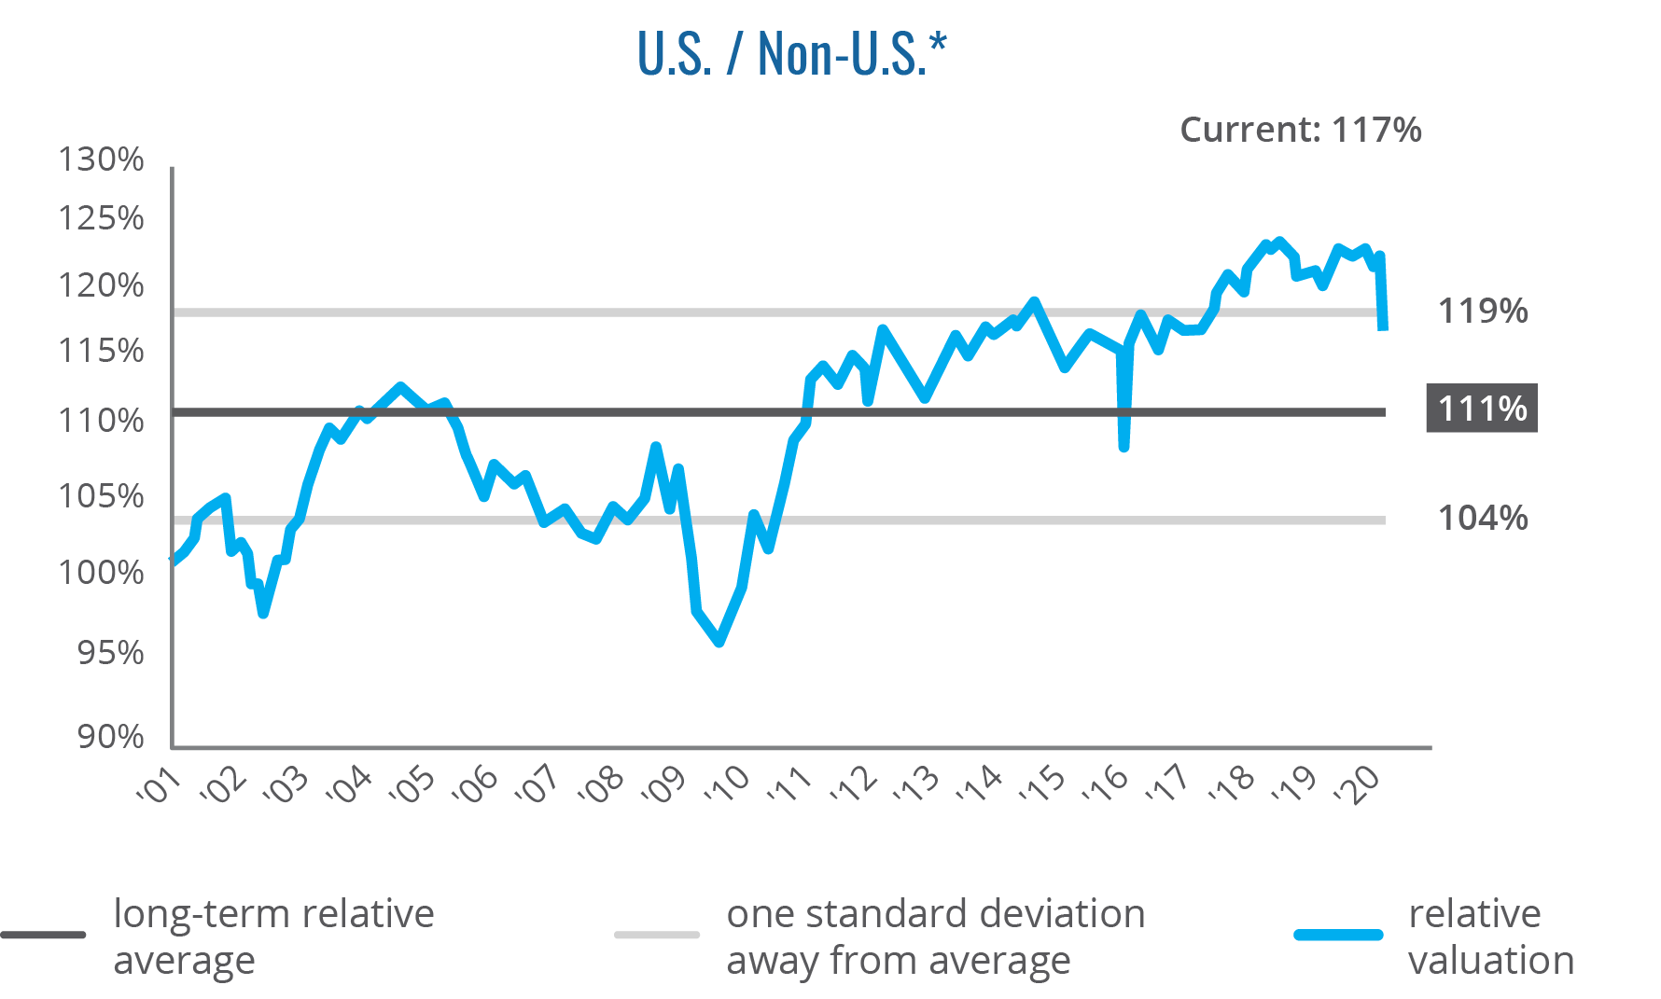
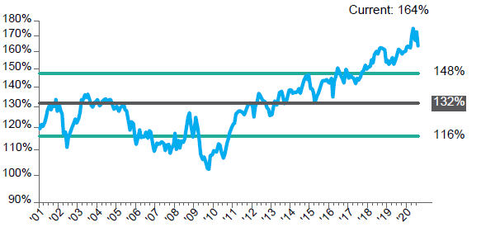
Domestic Stocks:
Not on Sale
The U.S. market is at high relative valuations as compared to most international markets.
The U.S market is currently expensive compared to most international markets.
The chart shows it trades at a 25% premium relative to the world.
* ETFs used where index data is unavailable
Source: Factset, as of 12/31/2020
0112-CLS-01/15/2021

Slide 14
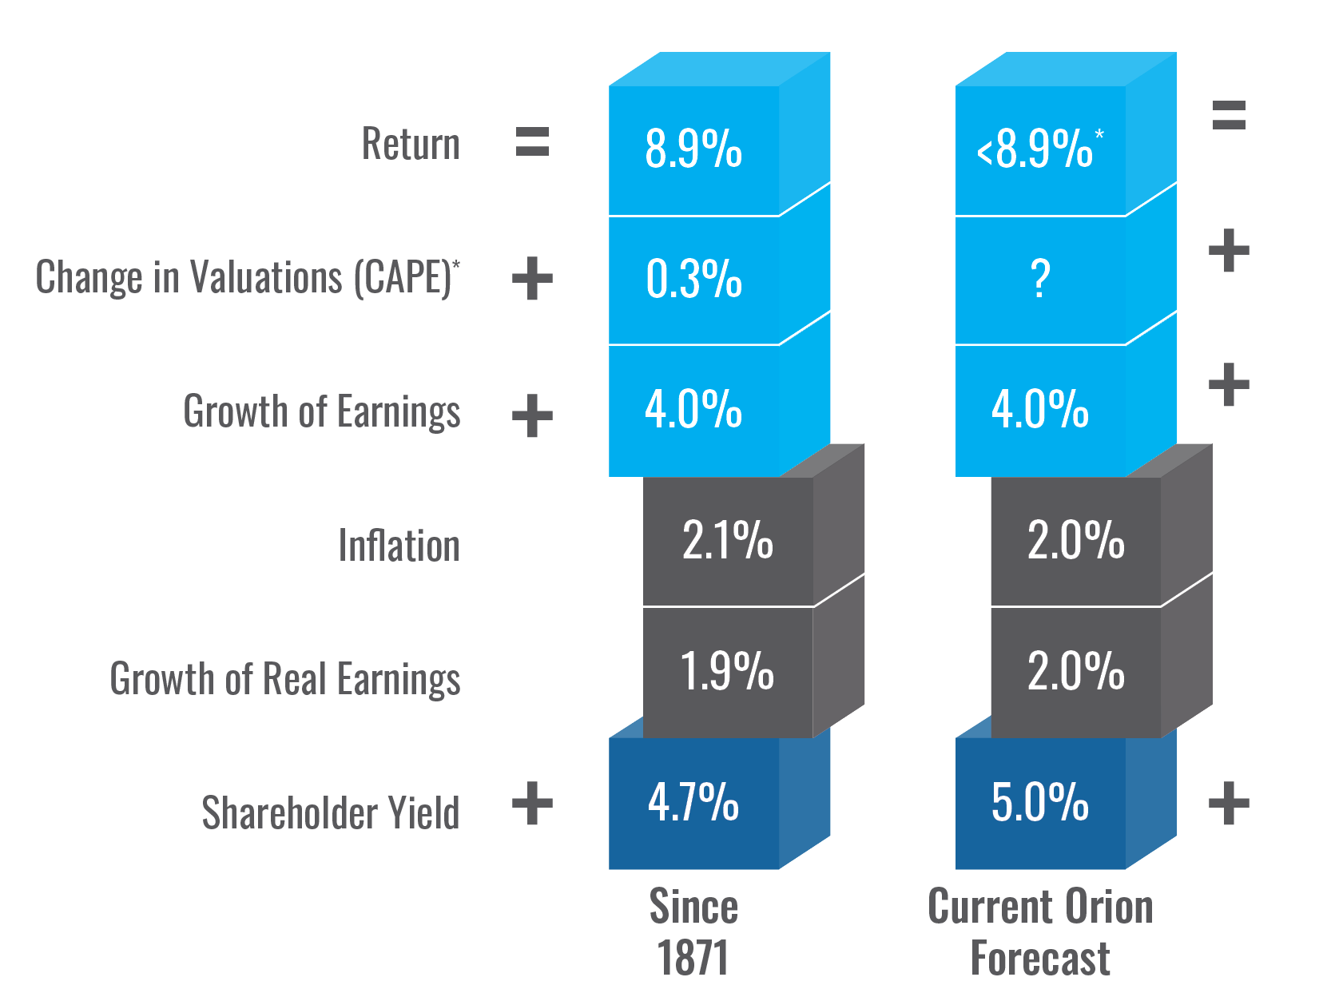
Stock Market Outlook:
The Building Blocks of Return
8.9%
<8.9%
All investments, including those in the stock market, get their returns from three sources: yield, growth of earnings, and change in valuations.
At Orion, we expect a downward move in valuations, and our expected U.S. stock market return is therefore going to be likely less than the long-term historic average.
0.4%
?
3.7%
3.9%
2%
2.3%
1.7%
1.6%
4.8%
4.8%
*Speculative
As of 12/31/2020 & Stock Market Data is from http://www.econ.yale.edu/~shiller/data.htm.
0112-CLS-01/15/2021

Slide 15
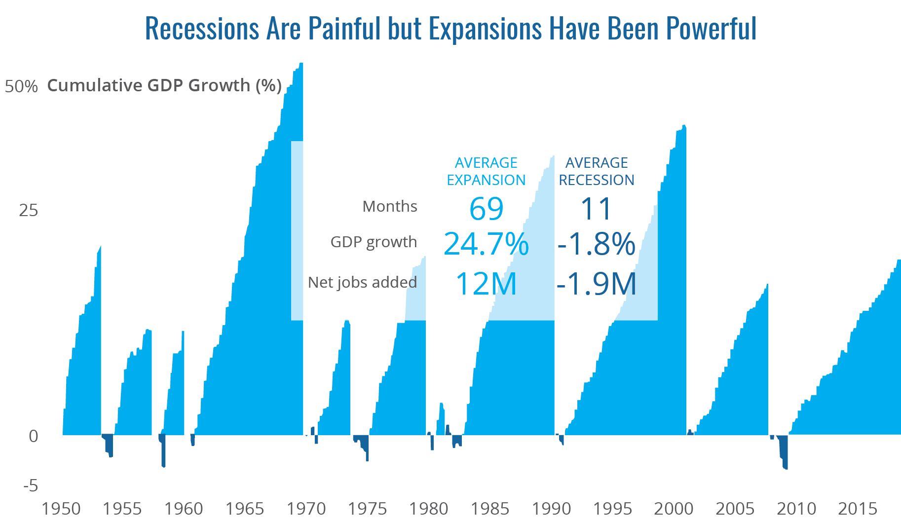
Stock Market Outlook: Market Impact of a Recession
While current economic data does not suggest a recession is coming any time soon, there are some signs of weakness in the economy. But even if a recession does happen, what is the impact on the markets? Recessions certainly don’t appear as bad when you compare them to the strength and length of historic expansions. A key takeaway is that average market performance during recessions has actually been positive.
Sources: Capital Group, National Bureau of Economic Research, Thomson Reuters. As of 12/31/19. Since NBER announces recession start and end months rather than exact dates, we have used month-end dates as a proxy for calculations of S&P 500 returns and jobs added. Nearest quarter-end values used for GDP growth rates. GDP growth shown on a logarithmic scale.
0112-CLS-01/15/2021

Slide 16
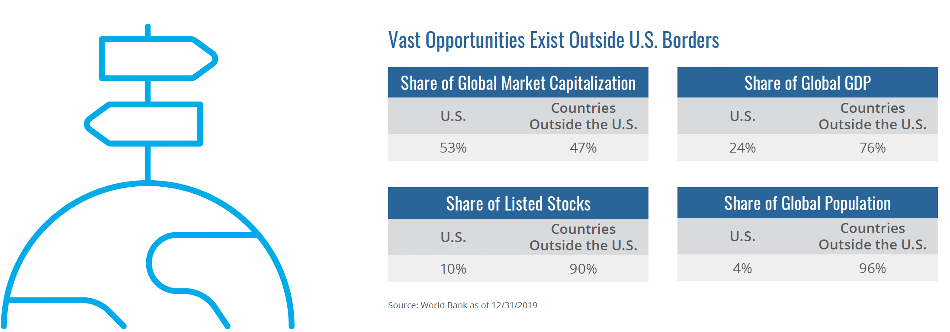
A World of Opportunities
International markets account for almost three-fourths of global GDP and 96% of the global population, but less than half of the global market capitalization.
Such weights suggest that the U.S. is overvalued relative to the rest of the world and there are opportunities for growth within the international markets.
0112-CLS-01/15/2021

Slide 17
Asset Class Outlook:
CLS Edge Scores
Expected returns for international markets are higher than those for the U.S.
On average, it is our expectation that international markets will return potentially up to 5.3% more than the U.S. over the next year using these assumptions.
Source: Morningstar, Bloomberg, Ned Davis Research, Research Affiliates, and MSCI, as of 12/31/20. Past performance is not a guide to future results.
CLS Score: A proprietary expected return measurement CLS calculates as a complement to our Risk Budgeting Methodology. It is constructed by first building a capital market assumption (CMA) for a broad asset class, then adding a valuation overlay, a technical overlay, and a cost adjustment for each ETF. The end result is an expected annualized return (the “CLS Score”) for every ETF we track.
0112-CLS-01/15/2021

Slide 18
Top Investment Reasons that Orion Believes Could Cause Markets to Rise or Fall
Reasons Markets Could Rise | Reasons Markets Could Fall
Successful Vaccine Distribution | U.S. Companies with Excessive Valuations (think FANMAG stocks) Miss Wall Street’s High Expectations
World Government Fiscal Stimulus | Poor Distribution of the Vaccine
Covid-19 Deaths Remain Low Despite Rising Cases | Return of Inflation
Fundamentally Sound International Companies Outperform Expectations | Defaults and Evictions Rise
Continued Low rates | Coronavirus Severity is Greater than Expected
0112-CLS-01/15/2021

Slide 19
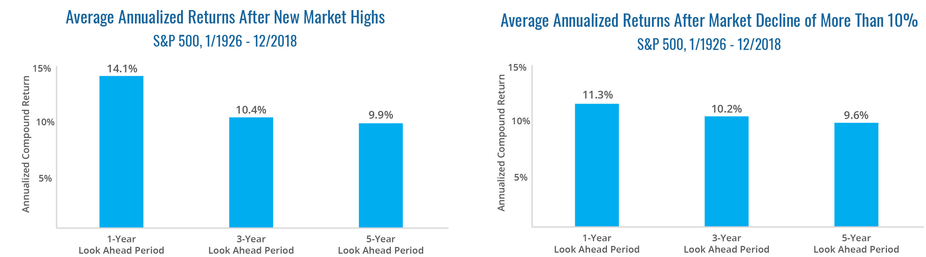
Is it Wise to Invest at Market Peaks or After a 10% Drop?
In 2018, the S&P 500 hit an all-time high and experienced a 10% decline.
Despite market positioning – whether at all-time highs or following a pullback – history suggests that it is a good time to invest.
Source: Dimensional Advisors
*Market decline of 10% is defined as a month in which cumulative return from peak is -10% or lower. Annualized compound returns are computed for the 1-, 3-and 5-year periods subsequent to a market decline of at least 10%. 1,093 observations for 1-year look-ahead. 1,069 observations for 3-year look-ahead, and 1,045 for 5-year look-ahead. 1-year, 3-year, and 5-year periods are overlapping periods. The bar chart shows the average returns for the 1-, 3-, and 5-year period following a market decline of at least 10%. January 1990-12/31/2017: S&P 500 Total Returns Index. S&P data © 2016 S&P Dow Jones Indices LLC, a division of S&P Global. All rights reserved. January 1926-December 1989; S&P 500 Total Return Index, Stocks, Bonds, Bills and Inflation Yearbook™, Ibbotson Associates, Chicago. For illustrative purposes only. Index is not available for direct investment; therefore, its performance does not reflect the expenses associated with the management of an actual portfolio. Past performance is no guarantee of future results. There is always a risk that an investor may lose money.
In US Dollars. Values represent the growth of $1 invested at market close 11/30/2017 in the S&P 500 Index (total return), © 2018S&P Dow Jones indices LLC, a division of S&P Global. All rights reserved. Past performance is no guarantee of future results. Short term performance results should be considered in connection with longer term performance results. Indices are not available for direct investment. Their performance does not reflect the expenses associated with the management of an actual portfolio.
0112-CLS-01/15/2021

Slide 20
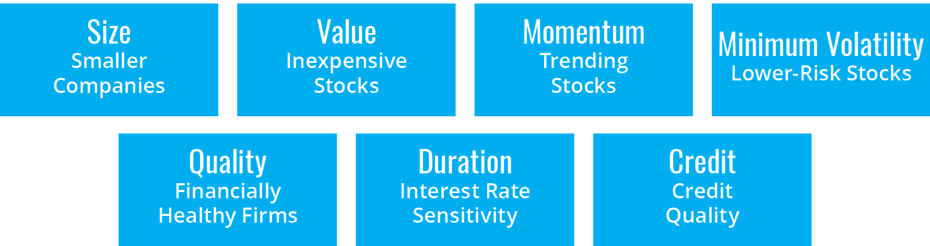
7 Key Factors of Smart Beta
An important subset of smart beta is factors, which are broad, persistent
drivers of risk and return. The seven factors CLS tends to emphasize are:
0112-CLS-01/15/2021

Slide 21
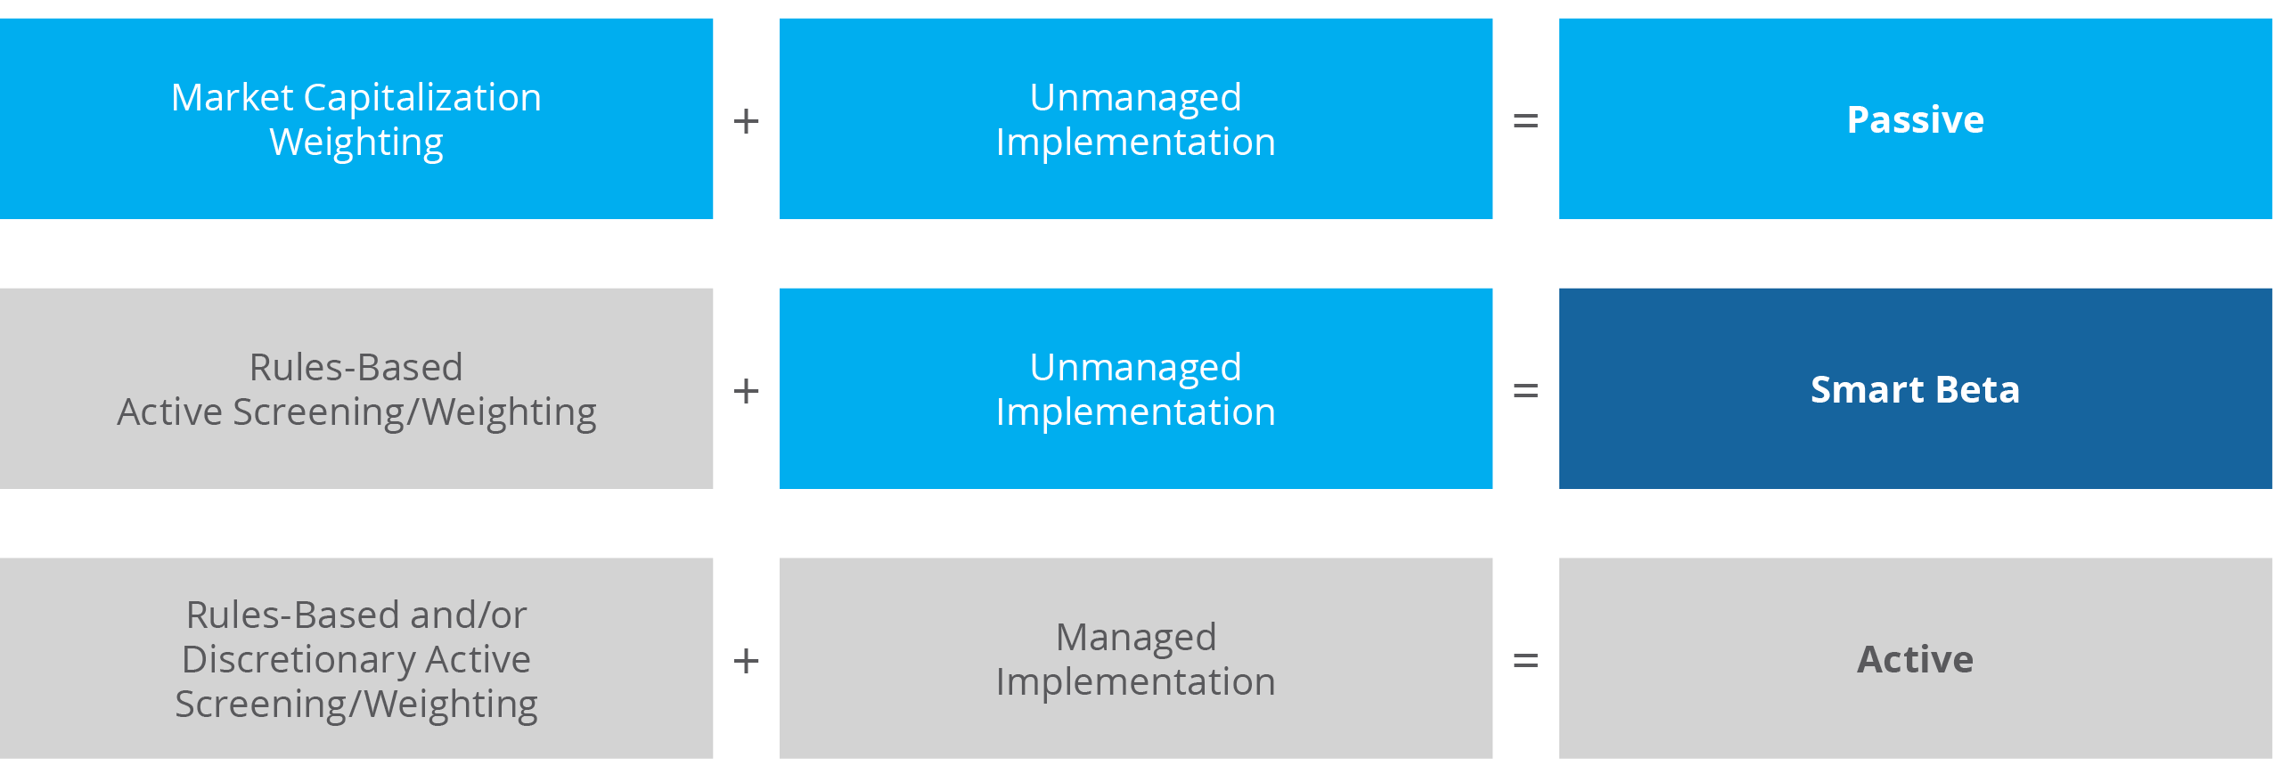
Why Smart Beta?
Smart Beta seeks to incorporate what we believe are the best attributes of passive and active investing to create a more innovative way to manage money.
Source: Morningstar
0112-CLS-01/15/2021

Slide 22
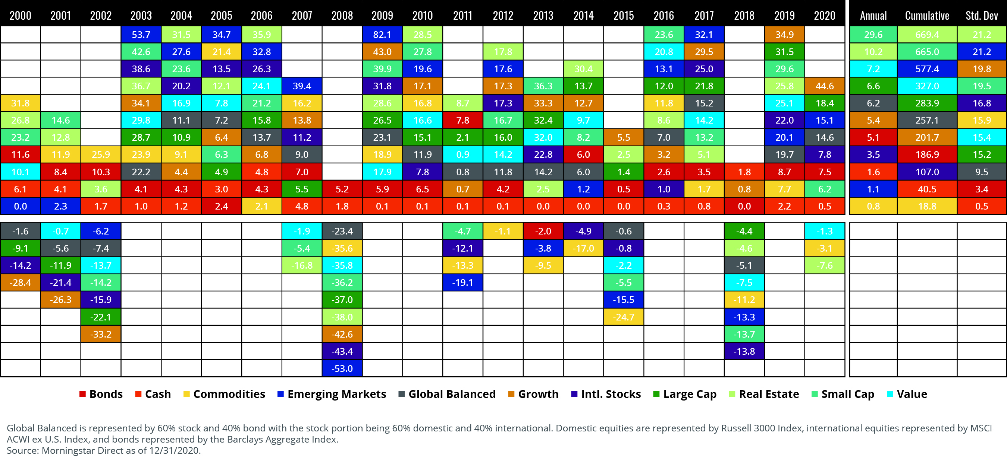
Balanced Portfolios Help Smooth Out Returns
Take a look at the extreme highs and lows of emerging markets over this time period, as compared to the much smoother returns for a global, balanced portfolio. Having exposure to a variety of asset classes limits the liability of a significant drop in any one asset class and provides a smoother ride for investors. Staying invested long-term can also help to smooth out returns.
0112-CLS-01/15/2021

Slide 23
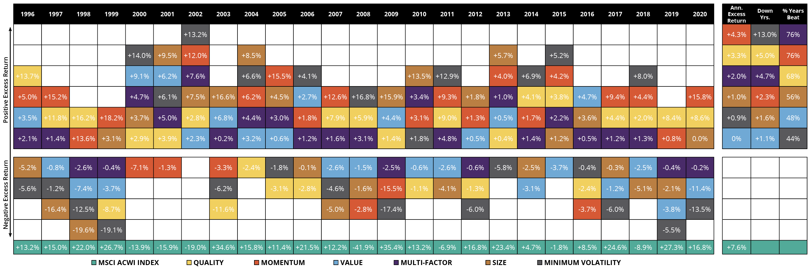
Factors Work - Equity
Strong bias toward positive relative returns
Even stronger bias when factors are equal weighted
Strongest bias when stock market is down
Excess Returns vs. MSCI ACWI
Source: Morningstar Direct as of 12/31/2020 . MSCI All Country World Factor Indexes relative to the MSCI All Country World Index (Gross Returns).
0112-CLS-01/15/2021

Slide 24
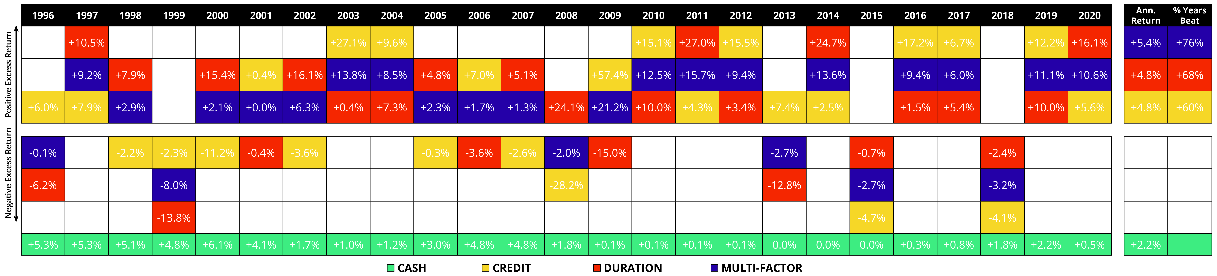
Factors Work – Fixed Income
Cyclicality of returns is apparent like with equity factors
Strong bias toward positive relative returns
Even stronger bias when factors are equal-weighted
Excess Returns vs. Cash
Source: Morningstar Direct as of 12/31/2020. IA SBBI US LT Govt TR USD Index and BofAML US HY Master II TR USD Index relative to the BBgBarc US Treasury Bill 1-3 Mon TR USD Index.
0112-CLS-01/15/2021

Slide 25
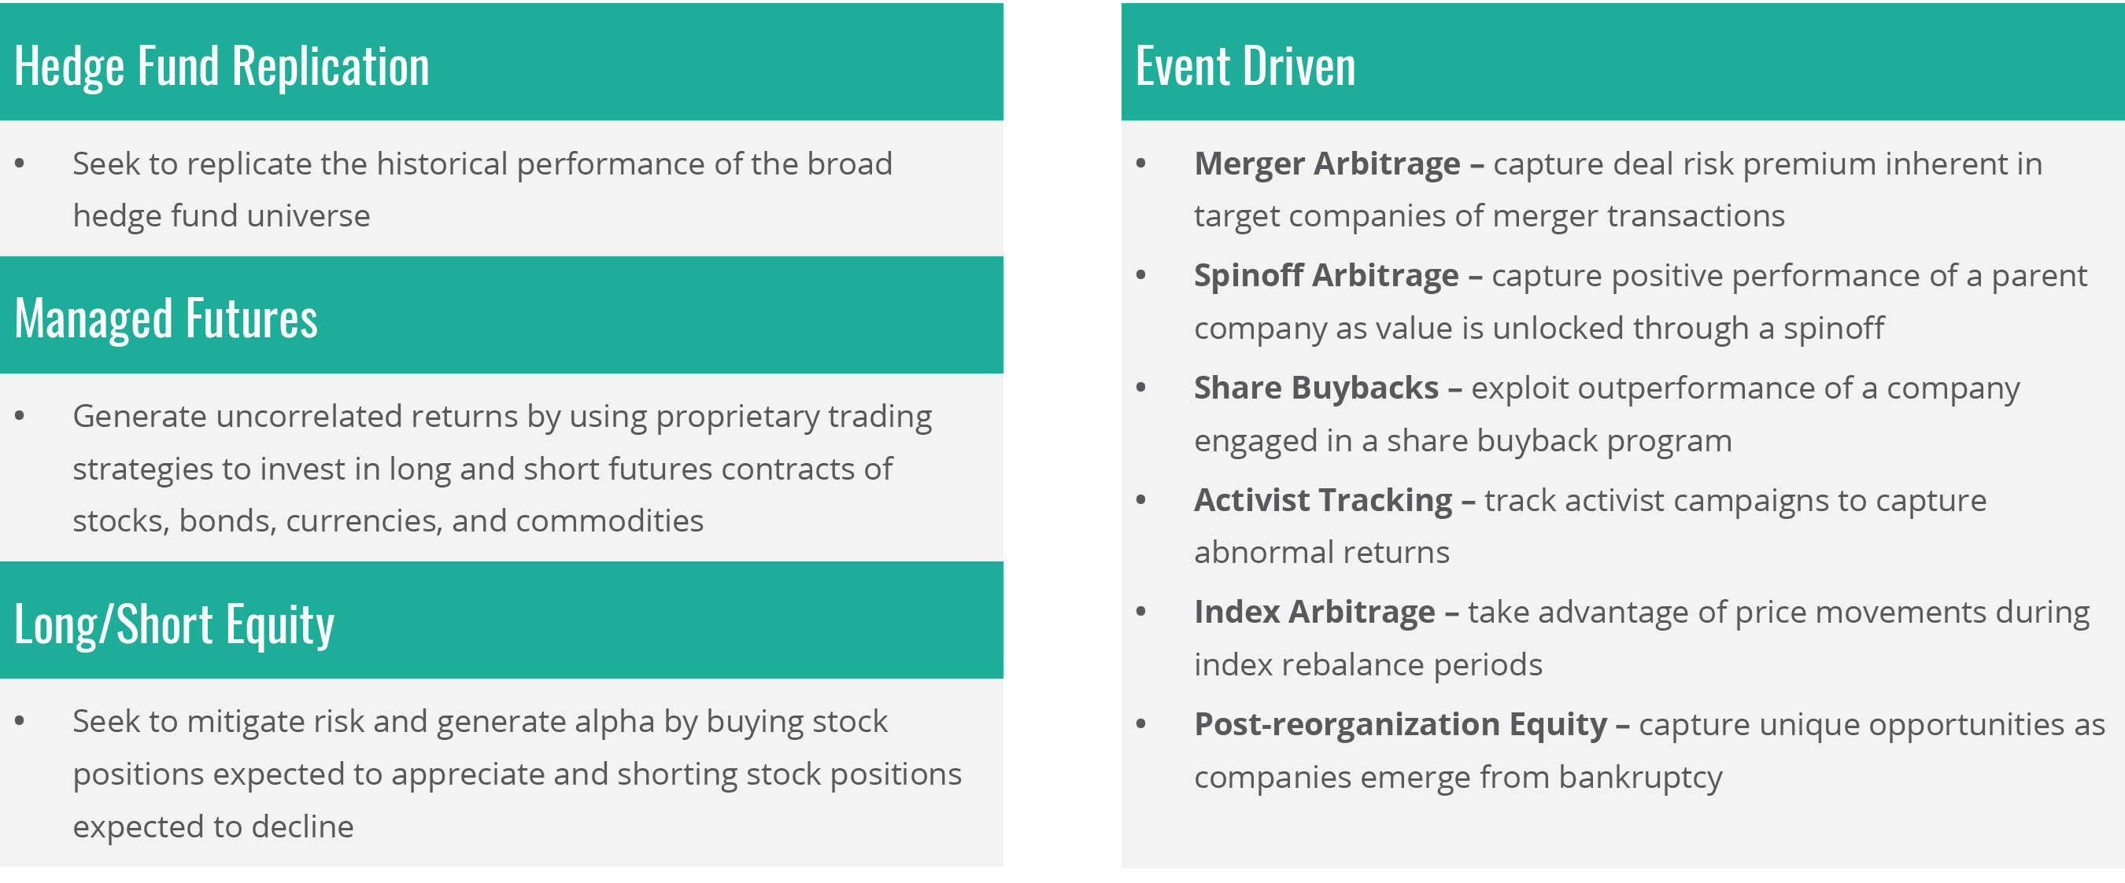
Alternative Investment Types
Alpha, also called the risk-adjusted return, is the difference between an asset’s expected return and its actual return.
0112-CLS-01/15/2021

Slide 26
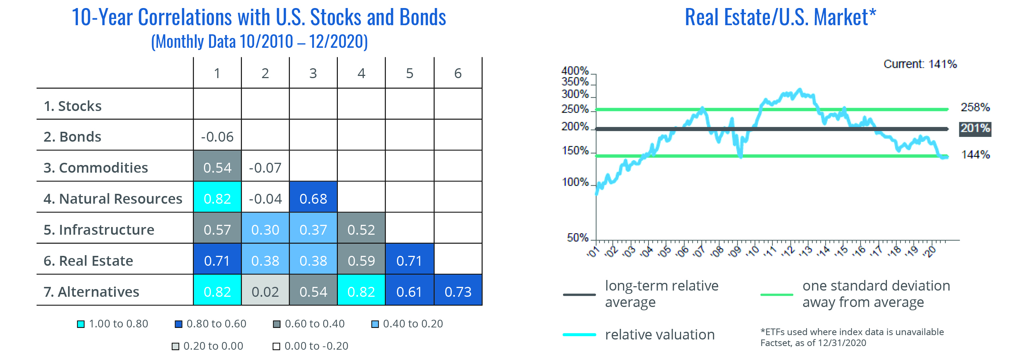
Real Assets Uncorrelated & Undervalued
Correlations of various real asset categories diversify exposures to stocks and bonds.
Real estate valuations are the most attractive in years, meaning the probability of outperformance going forward has increased.
Source: Morningstar Direct. Stocks represented by Morningstar US Market TR, Bonds represented by BBgBarc U.S. Agg Bond Index, Commodities represented by Bloomberg Commodity Index, Natural Resources represented by S&P North American Natural Resources, Infrastructure represented by MSCI USA Infrastructure Index, Real Estate represented by DJ U.S. Real Estate Index, Alternatives represented by Morningstar Diversified Alt Index.
0112-CLS-01/15/2021

Slide 27
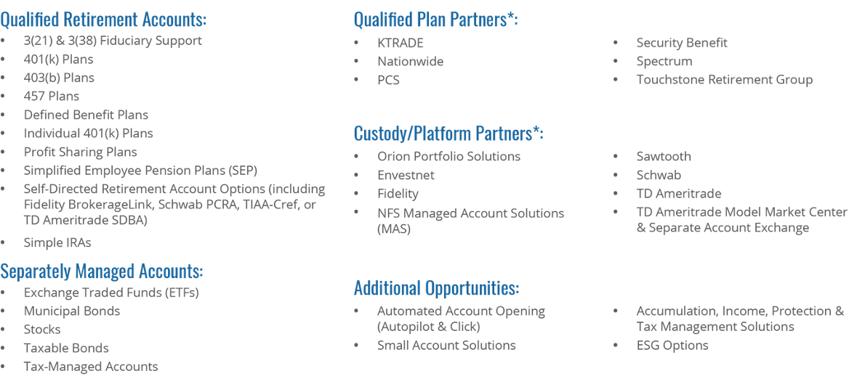
Additional Management Options & Partnerships
*CLS partners with many other variable annuity providers, qualified retirement plans, broker-dealers, and more. Ask a sales representative for more information. CLS Investments, LLC and Orion Portfolio Solutions, LLC are affiliated companies through their parent company Orion Advisor Solutions, LLC.
0112-CLS-01/15/2021

Slide 28

CLS Communication
CLS Monthly Perspectives
CLS Quarterly Market Outlook
CLS Quarterly Reference Guide
CLS Directions Newsletter
CLS Video Library
Orion “The Weighing Machine” Podcast
CLS Blog
CLS Monthly Chart Pack – Starting Points Matter
CLS White Paper Library
To receive the Quarterly Market Outlook and other CLS commentary, visit:
clsinvest.com/email-subscriptions
Follow Us on Social Media:
0112-CLS-01/15/2021

Slide 29
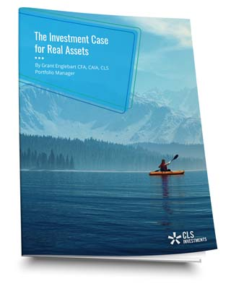
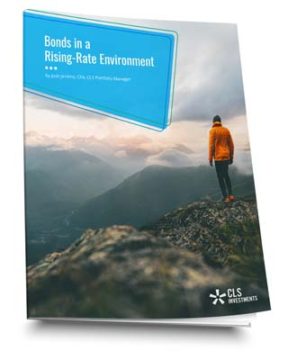

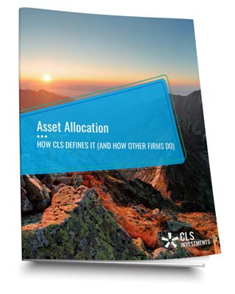
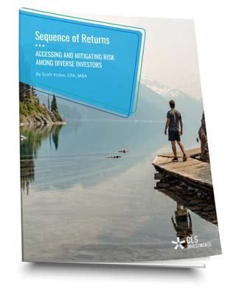
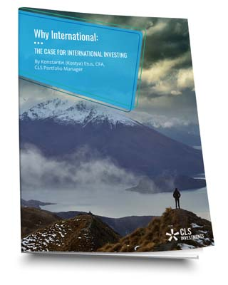


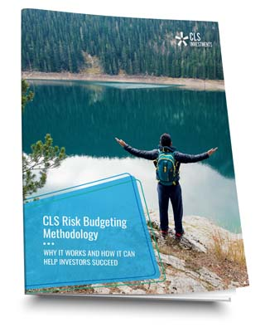
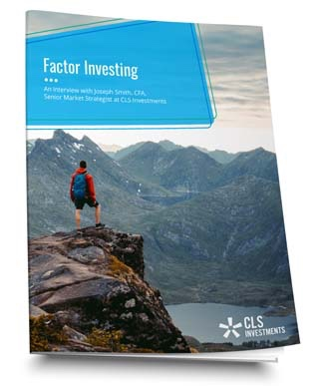
CLS Published Whitepapers
0112-CLS-01/15/2021

Slide 30
Contact Us
Investment Professionals
Grant Engelbart, CFA, CAIA
Senior Portfolio Manager
402.896.7163
grant.engelbart@clsinvest.com
Michael Hadden, CFA
Portfolio Manager
402.896.7139
michael.hadden@clsinvest.com
Case Eichenberger, CIMA®
Client Portfolio Manager
402.896.7004
case.eichenberger@clsinvest.com
Rusty Vanneman, CFA, CMT
Orion Chief Investment Strategist
402.896.7641
rusty@orion.com
0112-CLS-01/15/2021

Slide 31
Contact Us
Orion Sales Team
0112-CLS-01/15/2021

Slide 32
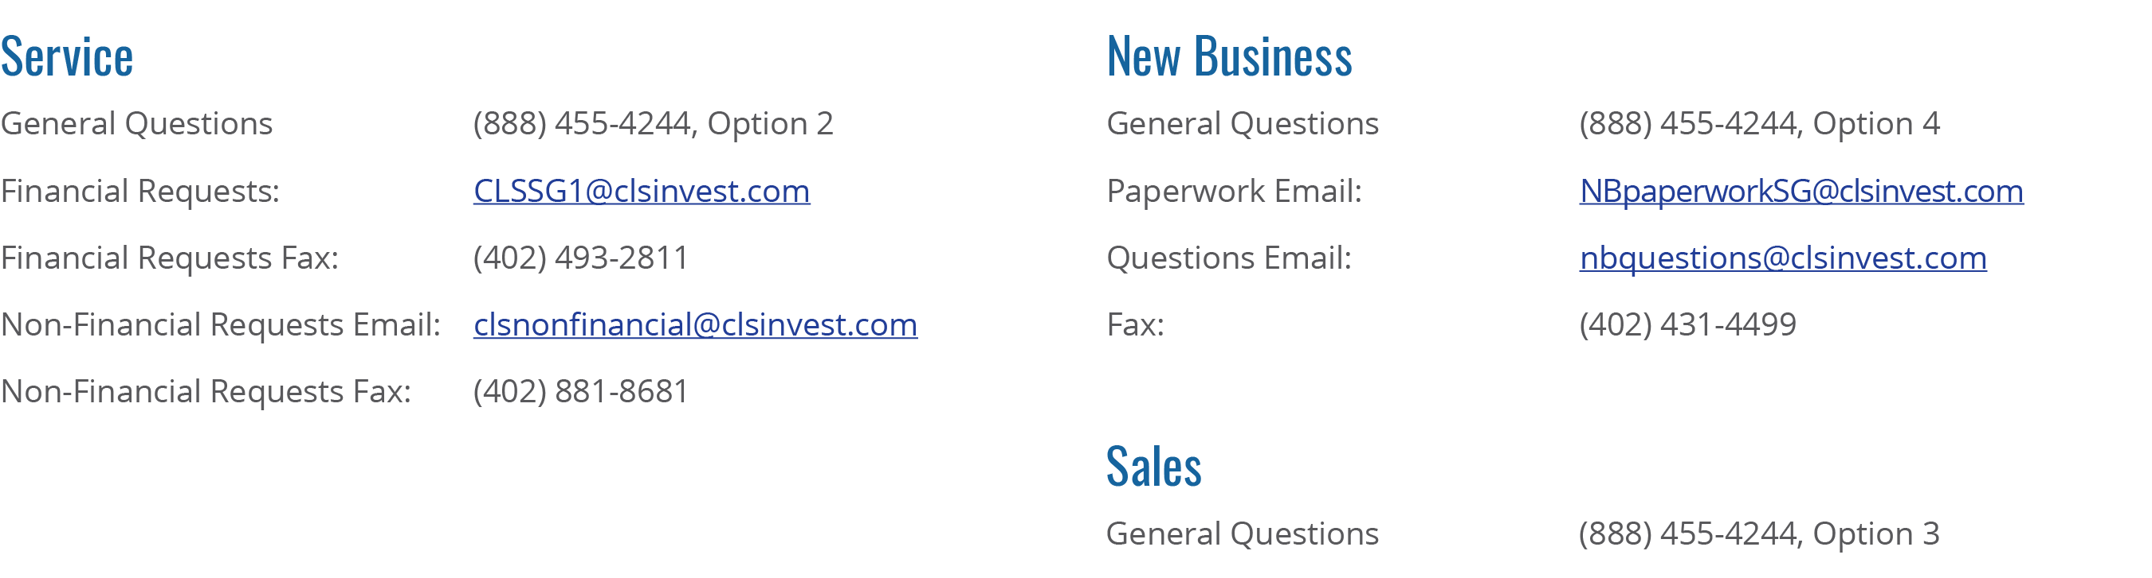
Contact Us
Additional CLS Contacts
0112-CLS-01/15/2021

Slide 33
Disclosures
The views expressed herein are exclusively those of CLS Investments, LLC, and are not meant as investment advice and are subject to change. No part of this report may be reproduced in any manner without the express written permission of CLS Investments, LLC. Information contained herein is derived from sources we believe to be reliable, however, we do not represent that this information is complete or accurate and it should not be relied upon as such. This information is prepared for general information only. It does not have regard to the specific investment objectives, financial situation and the particular needs of any specific person. You should seek financial advice regarding the appropriateness of investing in any security or investment strategy discussed here and should understand that statements regarding fu­ture prospects may not be realized. You should note that security values may fluctuate and that each security’s price or value may rise or fall. Accordingly, investors may receive back less than originally invested. Past performance is not a guide to future performance. Investing in any security involves certain systematic risks including, but not limited to, market risk, interest-rate risk, inflation risk, and event risk. These risks are in addition to any unsystematic risks associated with particular investment styles or strategies.
0112-CLS-01/15/2021

Slide 34
Disclosures
The S&P 500® Index is an unmanaged composite of 500-large capitalization companies. This index is widely used by professional investors as a performance benchmark for large-cap stocks. The MSCI All-Countries World Index, excluding U.S. (ACWI ex US) is an index considered representative of stock markets of developed and emerging markets, excluding those of the US. The Morningstar Global Market Large-Mid Index is an index that measures the performance of the global market’s equity markets targeting the top 90% of stocks by market capitalization. The Morningstar U.S. Market Index is an index that measures the performance of U.S. securities and targets 97% market capitalization coverage of the investable universe. It is a diversified broad market index. The Morningstar U.S. Large Cap Index is an index that measures the performance of U.S. large-cap stocks. These stocks represent the largest 70% capitalization of the investable universe. The Morningstar U.S. Small Cap Index is an index that measures the performance of U.S. small-cap stocks. These stocks fall between the 90th and 97th percentile in market capitalization of the investable universe. In aggregate, the Small Cap Index represents 7% of the investable universe. Morningstar Global ex U.S. Large-Mid Index is an index that measures the performance of Global Markets (ex-U.S.) equity markets targeting the top 90% of stocks by market capitalization. The Morningstar DM ex U.S. Large-Mid Index is an index that measures the performance of developed markets ex-U.S. equity markets targeting the top 90% of stocks by market capitalization. The Morningstar EM Large-Mid Index is an index that measures the performance of emerging markets targeting the top 90% of stocks by market capitalization. The Barclay’s Capital U.S. Aggregate Bond® Index measures the performance of the total United States investment-grade bond market. The Morningstar Cash Index is an index that measures the performance of a Treasury Bill with six to eight weeks until maturity in the U.S. market. The Bloomberg Commodity Index is made up of exchange-traded futures on physical commodities and represents commodities that are weighted to account for economic significant and market liquidity. This index provides investors with a means of understanding the performance of commodity futures markets and serves as a benchmark for investment performance of commodities as an asset class. The Morningstar Gbl Real Estate NR USD Index measures the performance of mortgage companies, property management companies and REITs. The volatility of the indexes may be materially different from the individual performance attained by a specific investor. In addition, portfolio holdings of investors may differ significantly from the securities that comprise the indexes. You cannot invest directly in an index.
CLS Strategies are not sponsored, endorsed, sold or promoted by Morningstar, Inc. or any of its affiliates (all such entities, collectively, “Morningstar Entities”). The Morningstar Entities make no representation or warranty, express or implied, to the owners of the CLS Strategies or any member of the public regarding the advisability of investing in CLS Strategies generally or in the specific strategy presented here in particular or the ability of the CLS Strategies to track general market performance.
THE MORNINGSTAR ENTITIES DO NOT GUARANTEE THE ACCURACY AND/OR THE COMPLETENESS OF THE CLS STRATEGIES OR ANY DATA INCLUDED THEREIN AND MORNINGSTAR ENTITIES SHALL HAVE NO LIABILITY FOR ANY ERRORS, OMISSIONS, OR INTERRUPTIONS THEREIN
The graphs and charts contained in this work are for informational purposes only. No graph or chart should be regarded as a guide to investing.
0112-CLS-01/15/2021

Slide 35
Certification Information
The CFA is a globally respected, graduate-level investment credential established in 1962 and awarded by CFA Institute — the largest global association of investment professionals. To learn more about the CFA charter, visit www.cfainstitute.org
CIMA ® professionals integrate a complex body of investment knowledge, ethically contributing to prudent investment decisions by providing objective advice and guidance to individual investors and institutional investors. To learn more about the CIMA, visit https://www.imca.org/cima
The CAIA® is the globally-recognized credential for professionals managing, analyzing, distributing, or regulating alternative investments. To learn more about the CAIA, visit https://caia.org/
The CMT Program demonstrates mastery of a core body of knowledge of investment risk in portfolio management. The Chartered Market Technician® (CMT) designation marks the highest education within the discipline and is the preeminent designation for practitioners of technical analysis worldwide. To learn more about the CMT, visit
https://cmtassociation.org/
0112-CLS-01/15/2021

Slide 36
Award Disclosures
Wealthmanagement.com & ETF.com Awards
CLS Investments, LLC (“CLS”) was selected as a finalist for WealthManagement.com’s 2020 Industry Awards in the category of Asset Managers- ETF Strategist. The WealthManagement.com Industry Awards program is an unbiased, third-party organization seeking to recognize companies that support financial advisors. Nominations for the WealthManagement.com Industry Awards were based on a submission from the company describing how it helps financial advisors work with clients. The award goes to the company selected by a Judges Panel made up of fifteen industry professionals. Winners of the award for each category will be announced September 10, 2020. WealthManagement.com is not affiliated with CLS. Ratings and awards may not be representative of any one client’s experience and are not indicative of CLS’s future performance.
CLS Investments, LLC was selected as a winner for ETF.com’s ETF Investor of the Year – 2019. ETF.com is an unbiased, third-party organization which specializes in providing resources on Exchange Traded Funds. ETF.com Award winners are selected in a three-part process. The process begins with open nominations where interested parties were invited to submit nominations. Self-nominations were accepted. Then the ETF.com Awards Nominating Committee – made up of ETF.com editorial staff– selected up to five finalists in each category. The winners are selected from these finalists by a majority vote of the ETF.com Awards Selection Committee, which is a group of independent ETF experts. ETF.com is not affiliated with CLS. Ratings and awards may not be representative of any one client’s experience and are not indicative of CLS’s future performance.
CLS Investments, LLC was selected as a winner for ETF.com’s ETF Investor of the Year – 2017. ETF.com is an unbiased, third-party organization which specializes in providing resources on Exchange Traded Funds. ETF.com Award winners are selected in a three-part process. The process begins with open nominations where interested parties were invited to submit nominations. Self-nominations were accepted. Then the ETF.com Awards Nominating Committee – made up of senior leaders at ETF.com and senior members of the FactSet ETF Analytics team – selected up to five finalists in each category. The winners are selected from these finalists by a majority vote of the ETF.com Awards Selection Committee, which is a group of independent ETF experts. ETF.com is not affiliated with CLS. Ratings and awards may not be representative of any one client’s experience and are not indicative of CLS’s future performance.
CLS Investments, LLC (“CLS”) was selected as a finalist for WealthManagement.com’s 2017 Industry Awards in the category, Asset Managers- ETF Strategist. The WealthManagement.com Industry Awards program is an unbiased, third-party organization seeking to recognize companies that support financial advisors. Nominations for the WealthManagement.com Industry Awards were based on a submission from the company describing how it helps financial advisors work with clients. The award goes to the company selected by a Judges Panel made up of ten industry professionals. Winners of the award for each category were announced October 11, 2017. WealthManagement.com is not affiliated with CLS. Ratings and awards may not be representative of any one client’s experience and are not indicative of CLS’s future performance.
0112-CLS-01/15/2021

Slide 37
Award Disclosures Continued
Wealthmanagement.com & ETF.com Awards
CLS Investments, LLC (“CLS”) was selected as a winner for WealthManagement.com’s 2016 Industry Awards in the category, Asset Managers- ETF Strategist. The WealthManagement.com Industry Awards program is an unbiased, third-party organization seeking to recognize companies that support financial advisors. Nominations for the WealthManagement.com Industry Awards were based on a submission from the company describing how it helps financial advisors work with clients. The award goes to the company selected by a Judges Panel made up of ten industry professionals. Winners of the award for each category were announced September 29, 2016. WealthManagement.com is not affiliated with CLS. Ratings and awards may not be representative of any one client’s experience and are not indicative of CLS’s future performance.
CLS Investments, LLC was a finalist for ETF.com’s ETF Strategist of the Year – 2014-2017. ETF.com is an unbiased, third-party organization which specializes in providing resources on Exchange Traded Funds. ETF.com Award winners are selected in a three-part process. The process began with open nominations where interested parties were invited to submit nominations. Self-nominations were accepted. Then the ETF.com Awards Nominating Committee – made up of senior leaders at ETF.com and senior members of the FactSet ETF team – voted for up to five finalists in each category. The winners were selected from these finalists by a majority vote of the ETF.com Awards Selection Committee, which was a group of independent ETF experts. Committee members recusd themselves from voting in any category in which their firm was named as finalist. ETF.com is not affiliated with CLS. Ratings and awards may not be representative of any one client’s experience and are not indicative of CLS’s future performance.
CLS Investments, LLC ("CLS") was selected as a finalist for WealthManagement.com's 2018 Industry Awards in the categories, Asset Managers: ETF Strategist, Socially Responsible Investing (SRI)/Impact Investing, Thought Leadership Initiative, and Thought Leadership Product Enhancement. The WealthManagement.com Industry Awards program is an unbiased, third-party organization seeking to recognize companies that support financial advisors. Nominations for the WealthManagement.com Industry Awards were based on a submission from the company describing how it helps financial advisors work with clients. The award goes to the company selected by a Judges Panel made up of eleven industry professionals. Winners of the award for each category were announced September 13, 2018. WealthManagement.com is not affiliated with CLS. Ratings and awards may not be representative of any one client's experience and are not indicative of CLS's future performance.
0112-CLS-01/15/2021

Slide 38
Award Disclosures Continued
Rusty Vanneman Money Management Executive Award
Orion Chief Investment Strategist, Rusty Vanneman, CFA, CMT, was selected as a “Top 10 Fund Managers to Watch” in 2017 by Money Management Executive. Money Management Executive is an unbiased, third-party publication covering the asset management industry. Money Management Executive chose the list of managers to watch by screening Morningstar data from funds with a single manager, ranked as having the best three-year annualized returns in their respective categories. The list of managers was published March 27, 2017. Money Management Executive is not affiliated with Orion. Ratings and awards may not be representative of any one client’s experience and are not indicative of Orion’s future performance.
Grant Engelbart Money Management Executive Award
CLS Investment, LLC (“CLS”) Portfolio Manager, Grant Engelbart, CFA, CAIA, was selected as a “Top 10 Fund Managers to Watch” in 2018 by Money Management Executive. Money Management Executive is an unbiased, third-party publication covering the asset management industry. Money Management Executive chose the list of managers to watch by screening Morningstar data from funds with a single manager, ranked as having the best three-year annualized returns in their respective categories. The list of managers was published March 12, 2018. Money Management Executive is not affiliated with CLS. Ratings and awards may not be representative of any one client’s experience and are not indicative of CLS’s future performance.
0112-CLS-01/15/2021

